Slide 1
Image Processing
Algorithm1: 3x3 Roberts Operator, abs norm, One threshold criteria
Algorithm2: Clipped first derivative filter in FD AND clipped second derivative filter in FD Two threshold criteria

Slide 2
Introduction
In the project we were asked to implement two algorithms for edge detection in the image (Edge Detection), and to improve the image obtained by using filters.
Edge recognition is helpful in identifying different objects and shapes in images by highlighting the boundaries of different objects in the image, using different color areas in the image.
Algorithm 1: Roberts Operator implementation according to Absolute normalization, single threshold value.
Algorithm 2: Using a First & second derivative filter in the frequency plane (FD), with two threshold values.
We were asked to create two images:
Image1 - A synthetic image of 5 rectangles of different sizes and colors.
Image2 - Image of fruits and vegetables in different colors (at least 5).

Slide 3
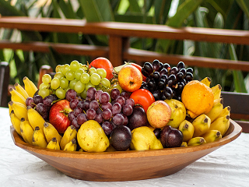
Image2.bmp
Real-life color Photo of fruits (containing at least 5 different fruits and non-trivial background).
We took our original photo:

Slide 4
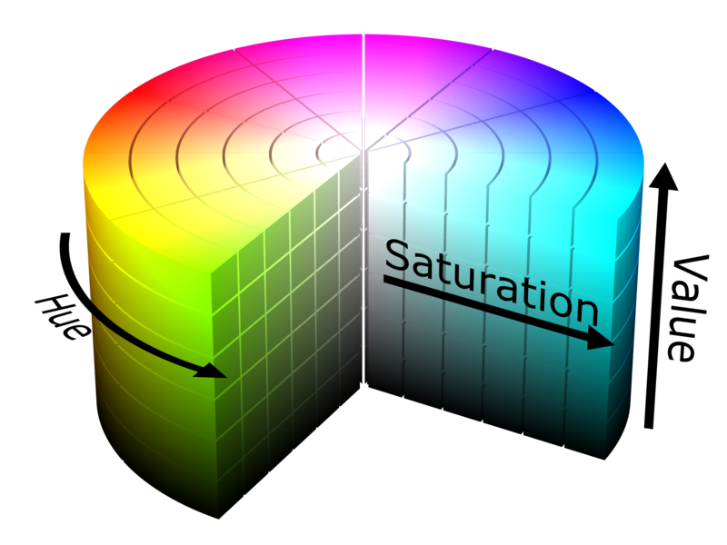
HSL Conversion
HSL (Hue Saturation Lightness) - A model for color separation based on a cylinder. The different colors are arranged in the circle and the base section of the cylinder so that each color is in a certain derivation of the circle.
This derivation (in degrees in the range of 0 - 360), is set as the hue value
Saturation value in HSL is calculated by using the transition value from full color to white. As we get closer to white color the saturation value will decrease.
The Lightness is the axis between white color and black. 100% = white while 0% = black.

Slide 5
HSL Conversion
In this project we took 3 images, turned them into gray level images and then we used the conversion to HSL.
We saved each image by value- "H" -hue, "S" -saturation, “L“ - lightness.
As a result we got 9 images from splitting to H, S, L, on which we performed the required algorithms.

Slide 6
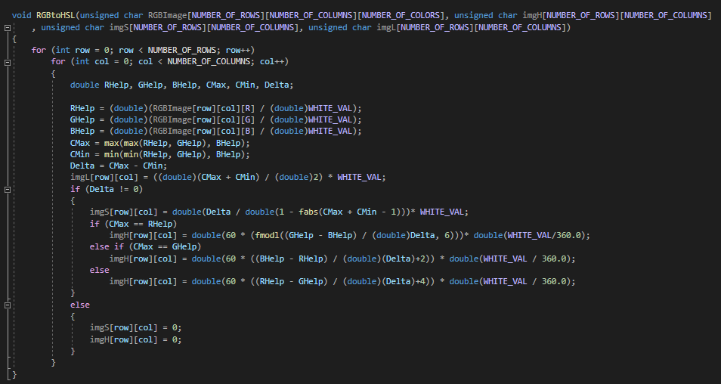
HSL Conversion Algorithm

Slide 7



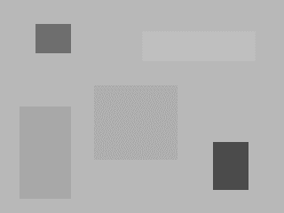
The images and their disassembly into HSL values
Img1.bmp
Img1H.bmp
Img1S.bmp
Img1L.bmp

Slide 8
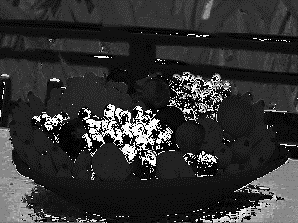
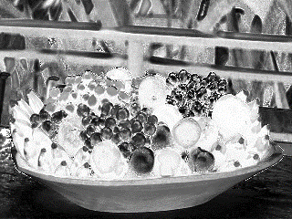
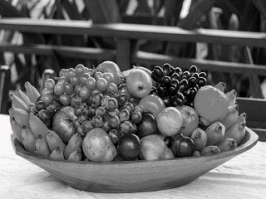
The images and their disassembly
into HSL values
Image2.bmp
Img2H.bmp
Img2S.bmp
Img2L.bmp

Slide 9
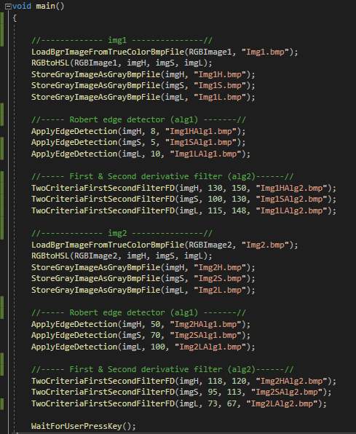

Slide 10



Algorithm 1: 3x3 Roberts Operator, abs norm, One threshold criteria
In this algorithm when there is an edge of an object which means a sharp change in the light density of the image, then it can be recognized that these pixels have an edge.
The idea behind the algorithm is to edit the image gradient using discrete differentiation which is achieved by calculating the sum of the absolute values ​​(or alternatively the sum of the squares) of the differences between adjacent pixels diagonally.
In fact, a two-dimensional spatial gradient is measured (finding a gradient) on an image, thus emphasizing areas that correspond to the edges. Here we will use to find the approximate absolute gradient size at each point in the grayscale input image (after we have worked on the color image and disassembled it according to the HSL method).
The Robert Operator consists of two matrices, one for the x-axis and the other for the y-axis.
We will perform a convolution operation between the matrix and the image and we will get the gradient in the direction of the matrix.
We will perform this operation in the X direction as well as in the Y direction and calculate the equivalent gradient according to:
$$G_{x}$$
$$G_{y}$$
$$|G|=|G_{x}|+{|G}_{y}|$$
0 | 0 | 1
0 | 0 | 0
-1 | 0 | 0
1 | 0 | 0
0 | 0 | 0
0 | 0 | -1

Slide 11
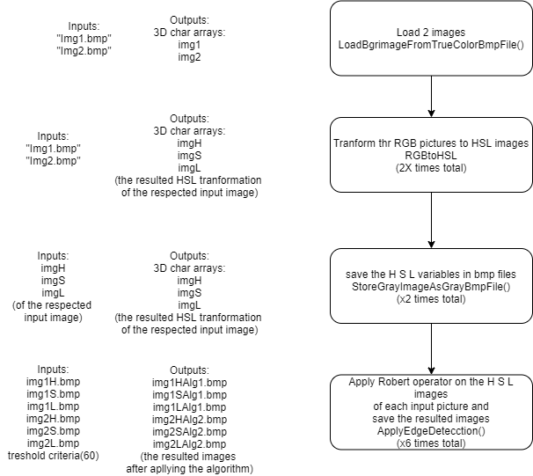
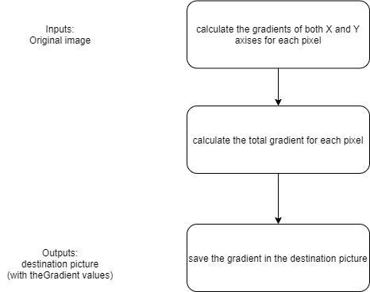
Algorithm 1 Flowchart:
RobertEdgeDetector

Slide 12
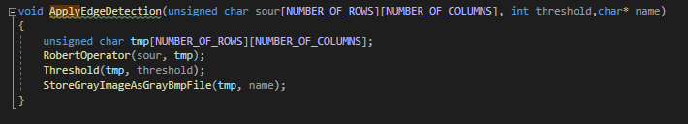
Important code parts in Algorithm 1:
Algorithm 1

Slide 13
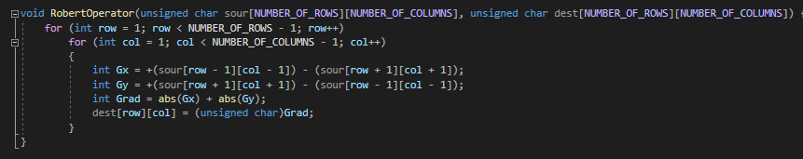
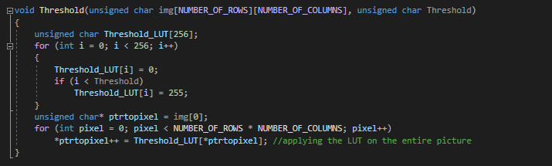
Important code parts in Algorithm 1:
RobertOperator
Threshold

Slide 14
Algorithm 2: Clipped first derivative filter in FD AND clipped second derivative filter in FD Two threshold criteria
In the algorithm above we will perform on the image a first derivative and a second derivative in the frequency plane. In each of the derivatives we will use the threshold value and as a result from the two derivatives we will get two threshold values.
Steps in performing the algorithm:
Image conversion in FFT.
Transfer the image through a first derivative filter and transform back to the time plane (TD).
The image transfer was obtained again through the filter, a second derivative was obtained and converted back to the time plane.
After getting the results we arbitrarily selected two threshold values ​​(trial and error) in order to get the best result, to determine the values ​​that will move to the binary image (black and white).

Slide 15
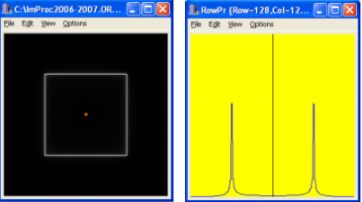
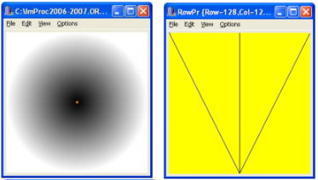
Algorithm 2: Clipped first derivative filter in FD AND clipped second derivative filter in FD Two threshold criteria
The filter that performs the first derivative is a cone filter - "Cone" which performs a frequency derivative on all sides of the image.
We will perform a multiplication between the filter and the image - a convolution in the time plane is equivalent to a multiplication in the frequency plane.

Slide 16
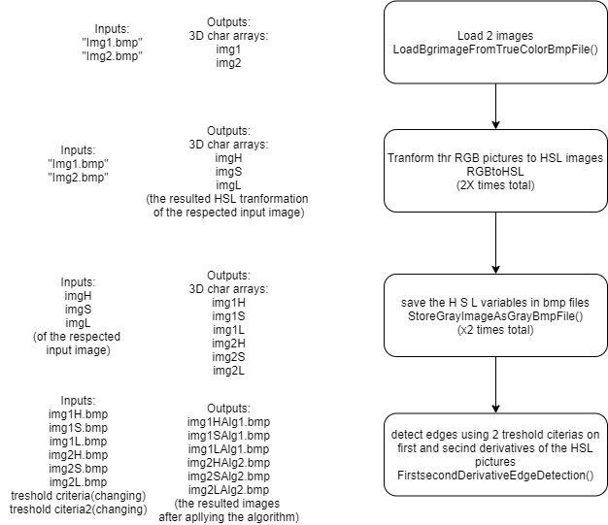
Algorithm 2 Flowchart:

Slide 17
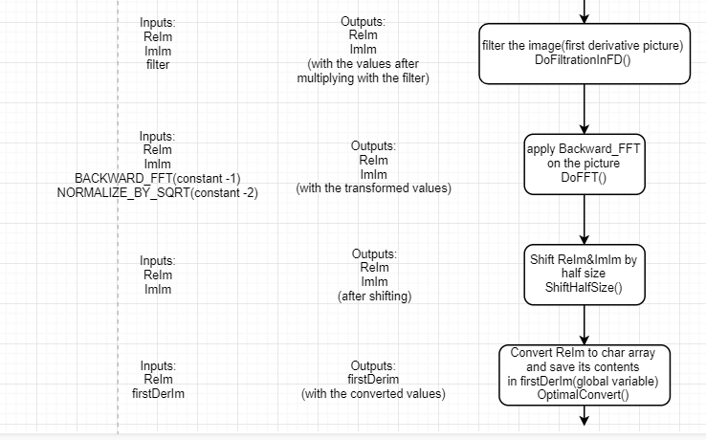
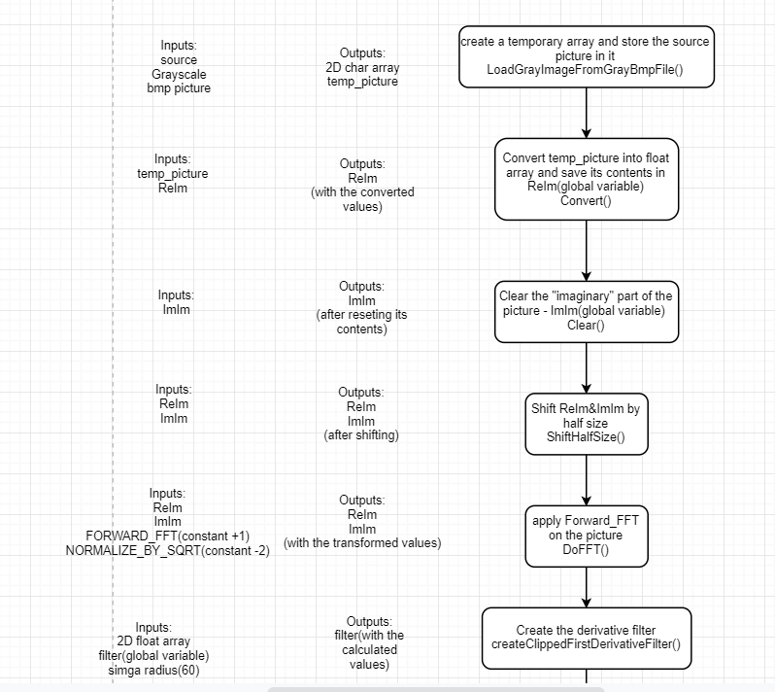
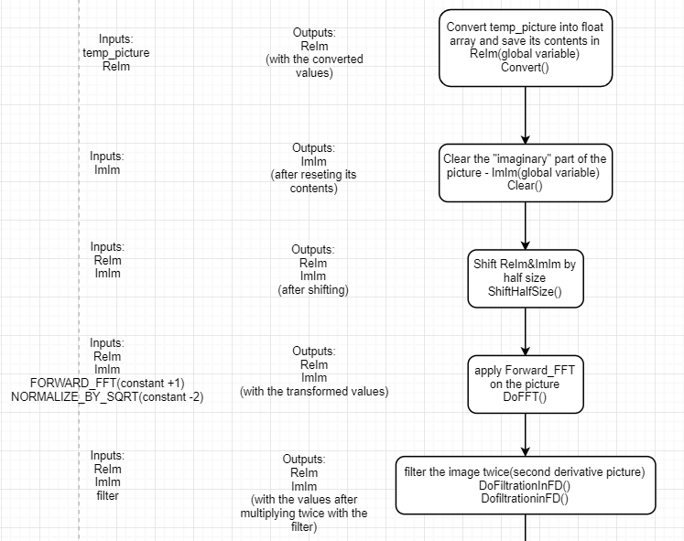
Algorithm 2 Flowchart:
FirstSecondDerivativeEdgeDetection():‏

Slide 18
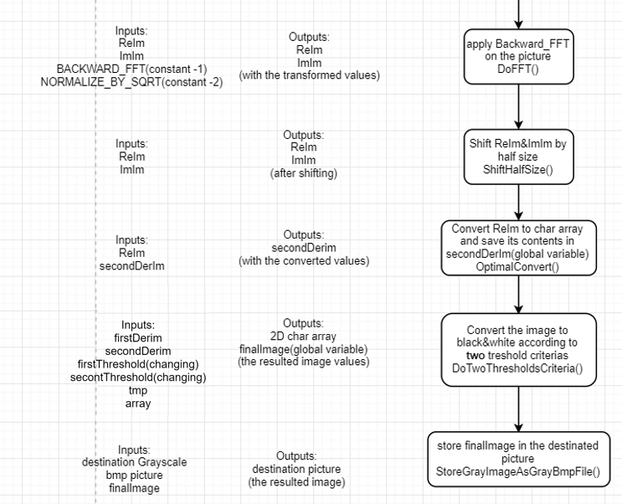
Algorithm 2 Flowchart:

Slide 19
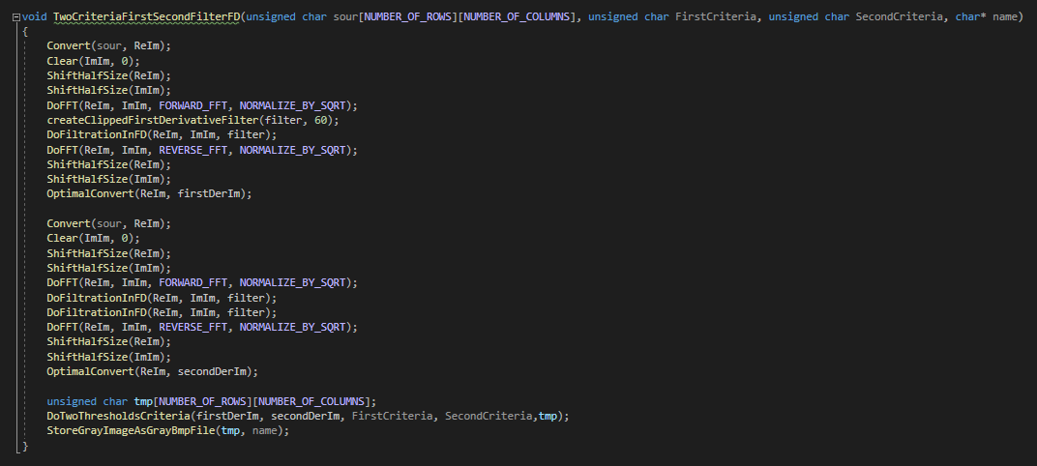
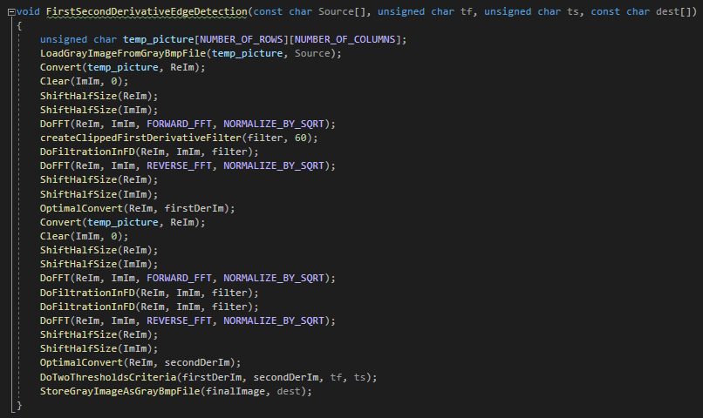
Important code parts in Algorithm 2:
Void TwoCriteriaFirstSecondFilterFD
FirstSecondDerivativeEdgeDetection‏

Slide 20
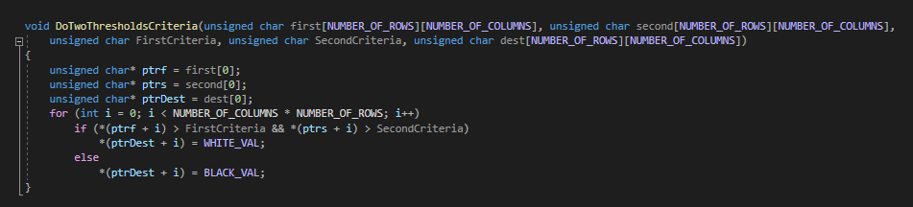
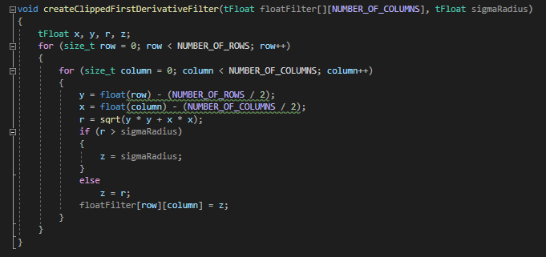
Important code parts in Algorithm 1:
DoTwoThresholdCriteria
createClippedFirstDerivativeFilter

Slide 21
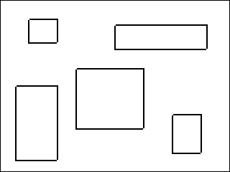
Analysis of Robert Operator Algorithm 1 results:
Image1 H|S|L
Img1HAlg1.bmp
Img1SAlg1.bmp
Img1LAlg1.bmp
We can see that the algorithm worked very well, and the result obtained identifies all the rectangles of the original image.
The threshold is selected by a Trial-and-error method and its value: 8
We can see that the algorithm worked very well, and the result obtained identifies all the rectangles of the original image.
The threshold is selected by a Trial-and-error method and its value: 5
We can see that the algorithm worked very well, and the result obtained identifies all the rectangles of the original image.
The threshold is selected by a Trial-and-error method and its value: 10
There are no significant visible differences between the three images.

Slide 22
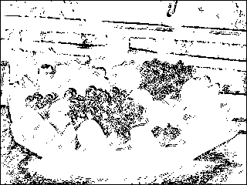
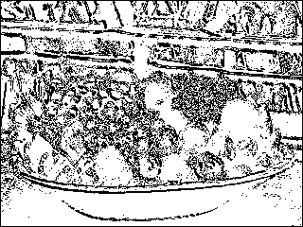
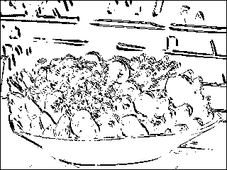
Analysis of Robert Operator Algorithm 1 results:
Img2 H|S|L
Img2HAlg1.bmp
Img2LAlg1.bmp
Img2SAlg1.bmp
We can see that the algorithm worked less well and the result obtained recognizes the “Shell" of the original image, but not the edge boundaries within the image, meaning there is identification of the fruits but without separation because there are overlaps that the algorithm could not detect.
The threshold is selected by an Trial and error method and its value: 50
In this image compared to the image on the left, we can see that the algorithm worked better and identified both all the fruits in the original image and the background. There are few overlaps that the algorithm was unable to detect.
The threshold is selected by an Trial and error method and its value: 70
In this image unlike the image on the left, you can see that the algorithm worked better and identified all the fruits in the original image. There are few overlaps that the algorithm was unable to detect.
The threshold is selected by an Trial and error method and its value: 100

Slide 23
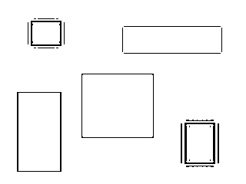
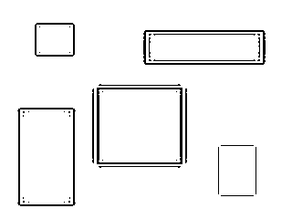
Algorithm 2 Results Analysis
Image1 H|S|L
Img1HAlg2.bmp
Img1SAlg2.bmp
Img1LAlg2.bmp
We can see that the algorithm worked quite well, and the result obtained recognizes all the rectangles of the original image. In some rectangles unnecessary edges were added due to overlaps that the algorithm could not detect and few of the lines have duplications.
The threshold is selected by a Trial-and-error method and its values: 123, 150
In this image we can see that the algorithm worked almost the same compared to the image on the left and identified all the edges compared to the original image. There are still a few overlaps that the algorithm did not detect (rectangle bottom right) and few of the lines have duplications.
The threshold is selected by a Trial-and-error method and its values: 100, 130
In this image we can see that the algorithm worked a little bit better compared to the images on the left and identified all the edges compared to the original image but still few of the lines have duplications.
The threshold is selected by a Trial-and-error method and its values: 115, 148

Slide 24
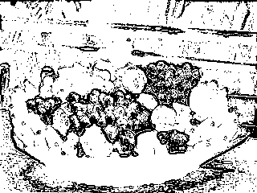
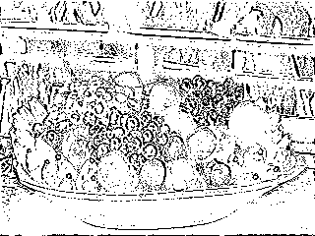
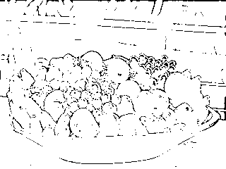
Algorithm 2 Results Analysis
Image2 H|S|L
Img2HAlg2.bmp
Img2SAlg2.bmp
Img2LAlg2.bmp
We can see that the algorithm worked less well and the result obtained only recognizes the “shell" of the original image. Meaning the boundaries were unclear and there are overlaps that the algorithm was unable to detect.
The threshold is selected by an Trial and error method and its values: 118, 120
In this image we can see that the algorithm worked significantly better compared to the image on the left and identified most of the edges compared to the original image. But there are still some overlaps that the algorithm has not detected.
The threshold is selected by an Trial and error method and its values: 95, 113
In this image we can see that the algorithm worked better compared to the images on the left, and identified almost all the edges compared to the original image. The fruit and tablecloth were well identified.
The threshold is selected by an Trial and error method and its values: 73, 67

Slide 25
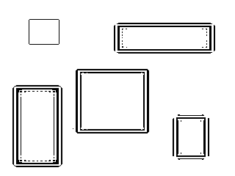
Algorithm comparison
Algorithm 2 | Algorithm 1
Img1HAlg2.bmp | Img1HAlg1.bmp
We can see that in algorithm 2 the result obtained is less clear, the algorithm does indeed recognize all the rectangles but at the edges there are overlaps and few of the lines have duplications therefore it fails to identify perfectly. In algorithm 1, on the other hand, a clearer result is obtained, and full identification of all the rectangles and boundaries. We think algorithm 1 is better in this case.

Slide 26
Algorithm comparison
Algorithm 2 | Algorithm 1
Img1SAlg2.bmp | Img1SAlg1.bmp
We can see that in algorithm 2 the result obtained is less clear, the algorithm does indeed recognize all the rectangles but at the edges there are overlaps and few of the lines have duplications therefore it fails to identify perfectly (bottom right rectangle). In Algorithm 1, on the other hand, a clearer result is obtained, and full identification of all the rectangles and boundaries. We think algorithm 1 is better in this case.

Slide 27
Algorithm comparison
Algorithm 2 | Algorithm 1
Img1LAlg2.bmp | Img1LAlg1.bmp
We can see that the two algorithms gave more or less the same result in identifying the edge edges of the image but still few of the lines have duplications. In our opinion the algorithm 1 is better in this case.

Slide 28
Algorithm comparison
Algorithm 2 | Algorithm 1
Img2HAlg2.bmp | Img2HAlg1.bmp
We can see that the two algorithms gave a more or less identical result in the identification from the "shell" of the fruit. Both have overlaps so they fail to differentiate within the boundaries of the items in the body of the image - each fruit and tablecloth in the background. In our opinion though this Algorithm 2 is better in this case.

Slide 29
Algorithm comparison
Algorithm 2 | Algorithm 1
Img2SAlg2.bmp | Img2SAlg1.bmp
We can see that in algorithm 1 the result obtained is less clear, the algorithm recognizes the edges and all the fruits but there are overlaps and therefore it fails to recognize the map in the background. In algorithm 2, on the other hand, a clearer result is obtained, still without the map but with full identification of all boundaries. In our opinion Algorithm 2 is preferred in this case.

Slide 30
Algorithm comparison
Algorithm 2 | Algorithm 1
Img2LAlg2.bmp | Img2LAlg1.bmp
We can see that in algorithm 1 the result obtained is less clear, the algorithm recognizes the edges and all the fruits, there are few overlaps and therefore it fails to fully identify the map in the background. In algorithm 2, on the other hand, a slightly clearer result is obtained, and there is a clear identification of the map and the highlighted fruits. In our opinion Algorithm 2 is preferred in this case.

Slide 31
Conclusions
We can see that the quality of the image is very important and how clear it is, in algorithm 1 better results were obtained in the rectangular image (synthetic image), whereas in algorithm 2 better results were obtained in the fruit image (real image).
We can say that the use of 2 threshold values ​​and a shear filter provided better results in most cases and the edges were very clear.
From the results we obtained and their analysis, it seems that in most of the images from all the comparisons Algorithm 1 worked better compared to Algorithm 2.
In some cases, there was no better algorithm as the result was very similar.
The selected threshold values ​​gave us an optimal result.

Slide 32
Bibliography
Tomasi C.(may 17, 2003). Convolution, Smoothing, and Image Derivatives. Retrieved from https://www2.cs.duke.edu/courses/spring03/cps296.1/handouts/Image%20Processing.pdf
Wikipedia, the free encyclopedia. Roberts cross - Wikipedia. Retrieved from https://en.wikipedia.org/wiki/Roberts_cross
R. Fisher, S. Perkins, A. Walker and E. Wolfart, A. (2003). Roberts Cross Edge Detector Retrieved from https://homepages.inf.ed.ac.uk/rbf/HIPR2/roberts.htm

